Slide 1
CSCE 623 In Class Day 15
Synchronous session

Slide 2
Agenda
Roll Call // Start Recording
Key points for Support Vector Methods
SV Method exploration
Break
Questions & Project Discussion

Slide 3
Key Points for Support Vector Methods
Maximizing Margins & Support Vectors
Soft Margin Classification
Achieving linear separability in higher dimensions
Kernel Trick
Benefits and Limitations of SVM
SOURCES
Andrew Moore
2001 SVM tutorial at
http://www.cs.cmu.edu/~awm/tutorials
Mingyue Tan
The University of British Columbia
Nov 26, 2004
www.baskent.edu.tr/~hogul/svm_tutorial.ppt

Slide 4
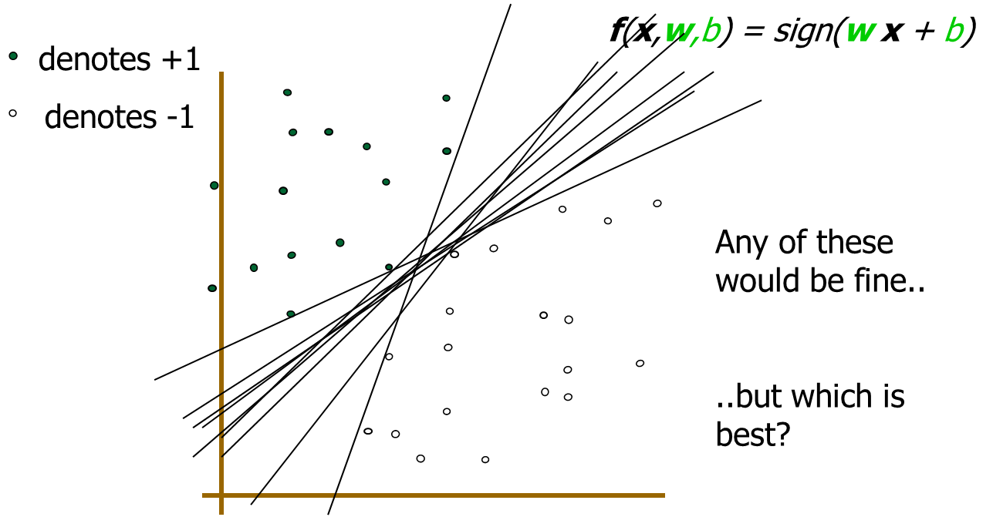
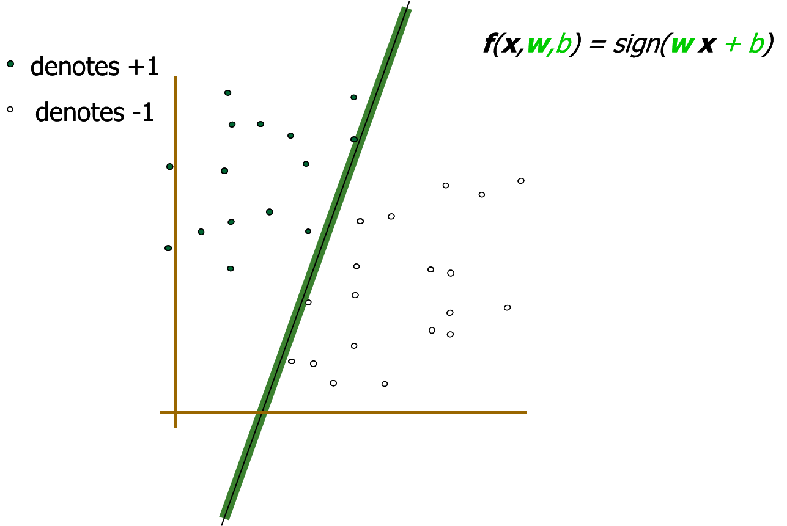
Intuition for margins and support vectors

Slide 5
Intuition for margins and support vectors
α
x
f
y^{est}
Maximizing the margin is good according to intuition
Implies that only support vectors are important; other training examples are ignorable.
f(x,w,b) = sign(w x + b)
denotes +1
denotes -1
The maximum margin linear classifier is the linear classifier with the maximum margin.
This is the simplest kind of SVC
Support Vectors are those datapoints that the margin pushes up against

Slide 6
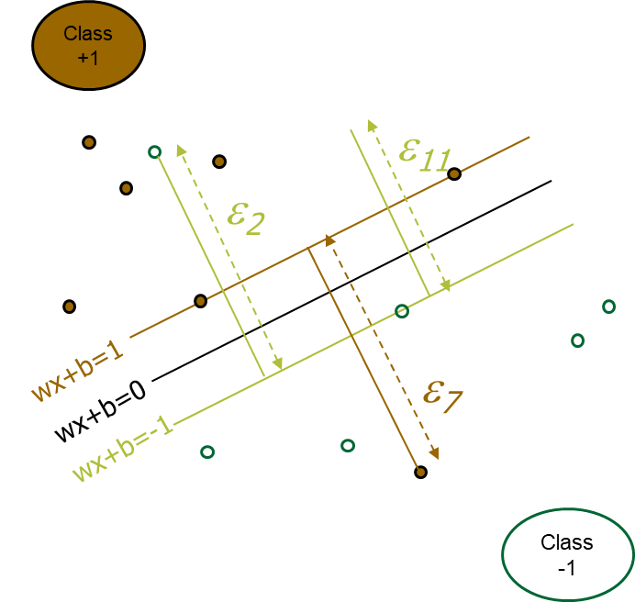
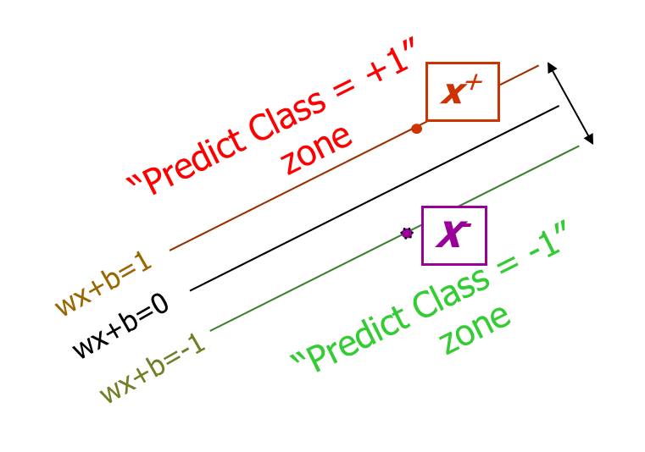
Hard Margins v. Soft Margins
In hard margin classifiers, observations within the margin are the only thing that affect fit: can lead to overfitting
minimize
Subject to
In Soft Margin Classifiers, parameter C controls how much the soft margin errors impact the model fit:
Tunable flexibility with LOWER values = more regularization

Slide 7

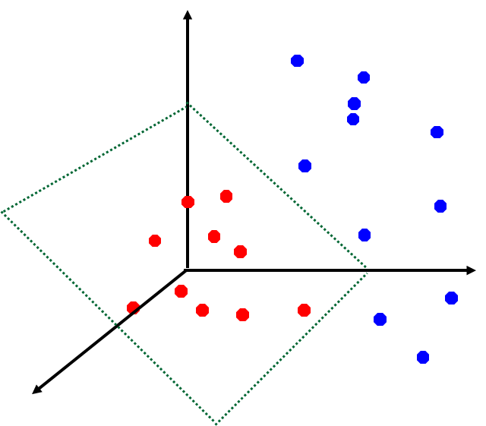
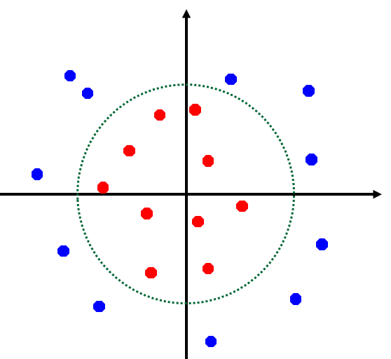
Achieving linear separability in higher dimensions
x²
Φ: x → φ(x)

Slide 8
Kernel Trick: higher dimensionality for the similarity function
To fit and use an SVM, we need to know the dot product of pairs of observations – represents similarity in feature space.
Naive solution: for each observation, compute its higher-dimensional representation and then compute the dot product between observations: COMPUTATIONALLY EXPENSIVE!
Kernel Trick: A kernel function yields the answer to the dot product in the higher dimensional space without explicitly converting the observations into that space first: COMPUTATIONALLY CHEAPER!
The optimization function for SVM doesn’t change… we just replace the original distance function with the Kernel function

Slide 9
Common Kernel Functions
Linear: K(x_{i},x_{j})= x_{i} ^{T}x_{j}
Polynomial of order p: K(x_{i},x_{j})= (1+ x_{i} ^{T}x_{j})^{p}
Gaussian (radial-basis function (RBF)):
Sigmoid: K(x_{i},x_{j})= tanh(β₀x_{i} ^{T}x_{j} + β₁)

Slide 10
Benefits and limitations of SVM
Options for similarity function –
More decisions to make w/kernel
Sparseness of solutions with large datasets (only support vectors needed)
Complexity doesn’t depend on dim of feature space
Soft margin has tunable regularization
more decisions to make during hyperparameter tuning
Convex optimization: Guaranteed global solutions
Can be slow to train

Slide 11
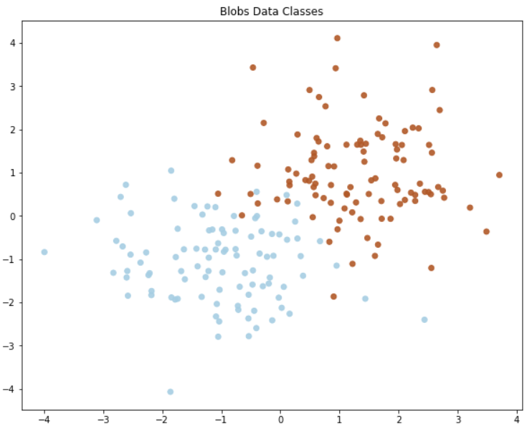
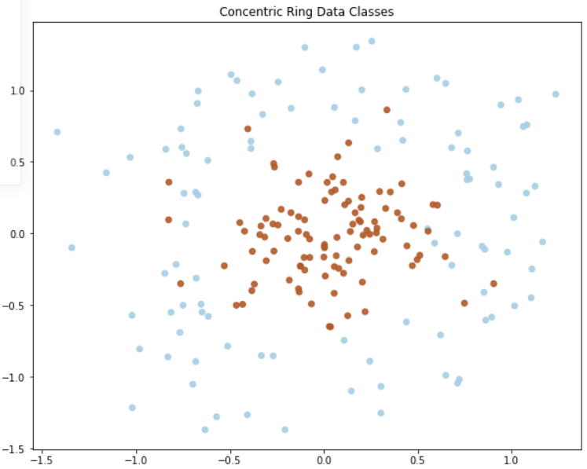
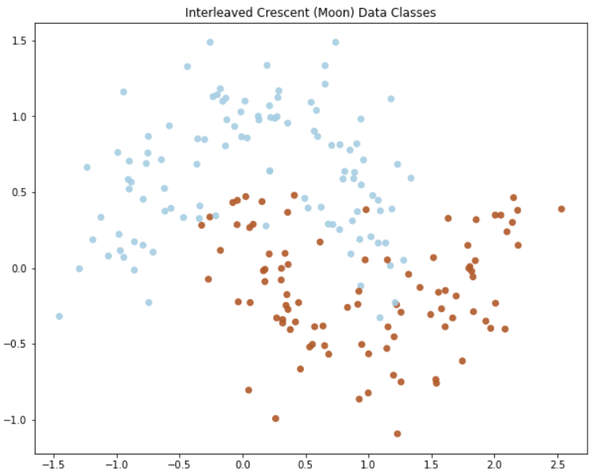
SVM Coding Activity
Obtain the code from Canvas
Instructor Overview / Description of Task
Model decision-making for fitting to 3 datasets
Breakout Groups to work on coding (15 min)
Share your results

Slide 12
Break
Raise Hands
Take 5 min break
Lower hands when returned

Slide 13
Questions & Open Project Discussion

